Slide 1

About PTSD
Lisa 912

Slide 2
Content
What PTSD is
The history of PTSD
Some way to come over PTSD

Slide 3

What is PTSD?
An anxiety disorder associated with serious traumatic events and characterized by such symptoms as survivor guilt, reliving the trauma in dreams, numbness and lack of involvement with reality, or recurrent thoughts and images。

Slide 4
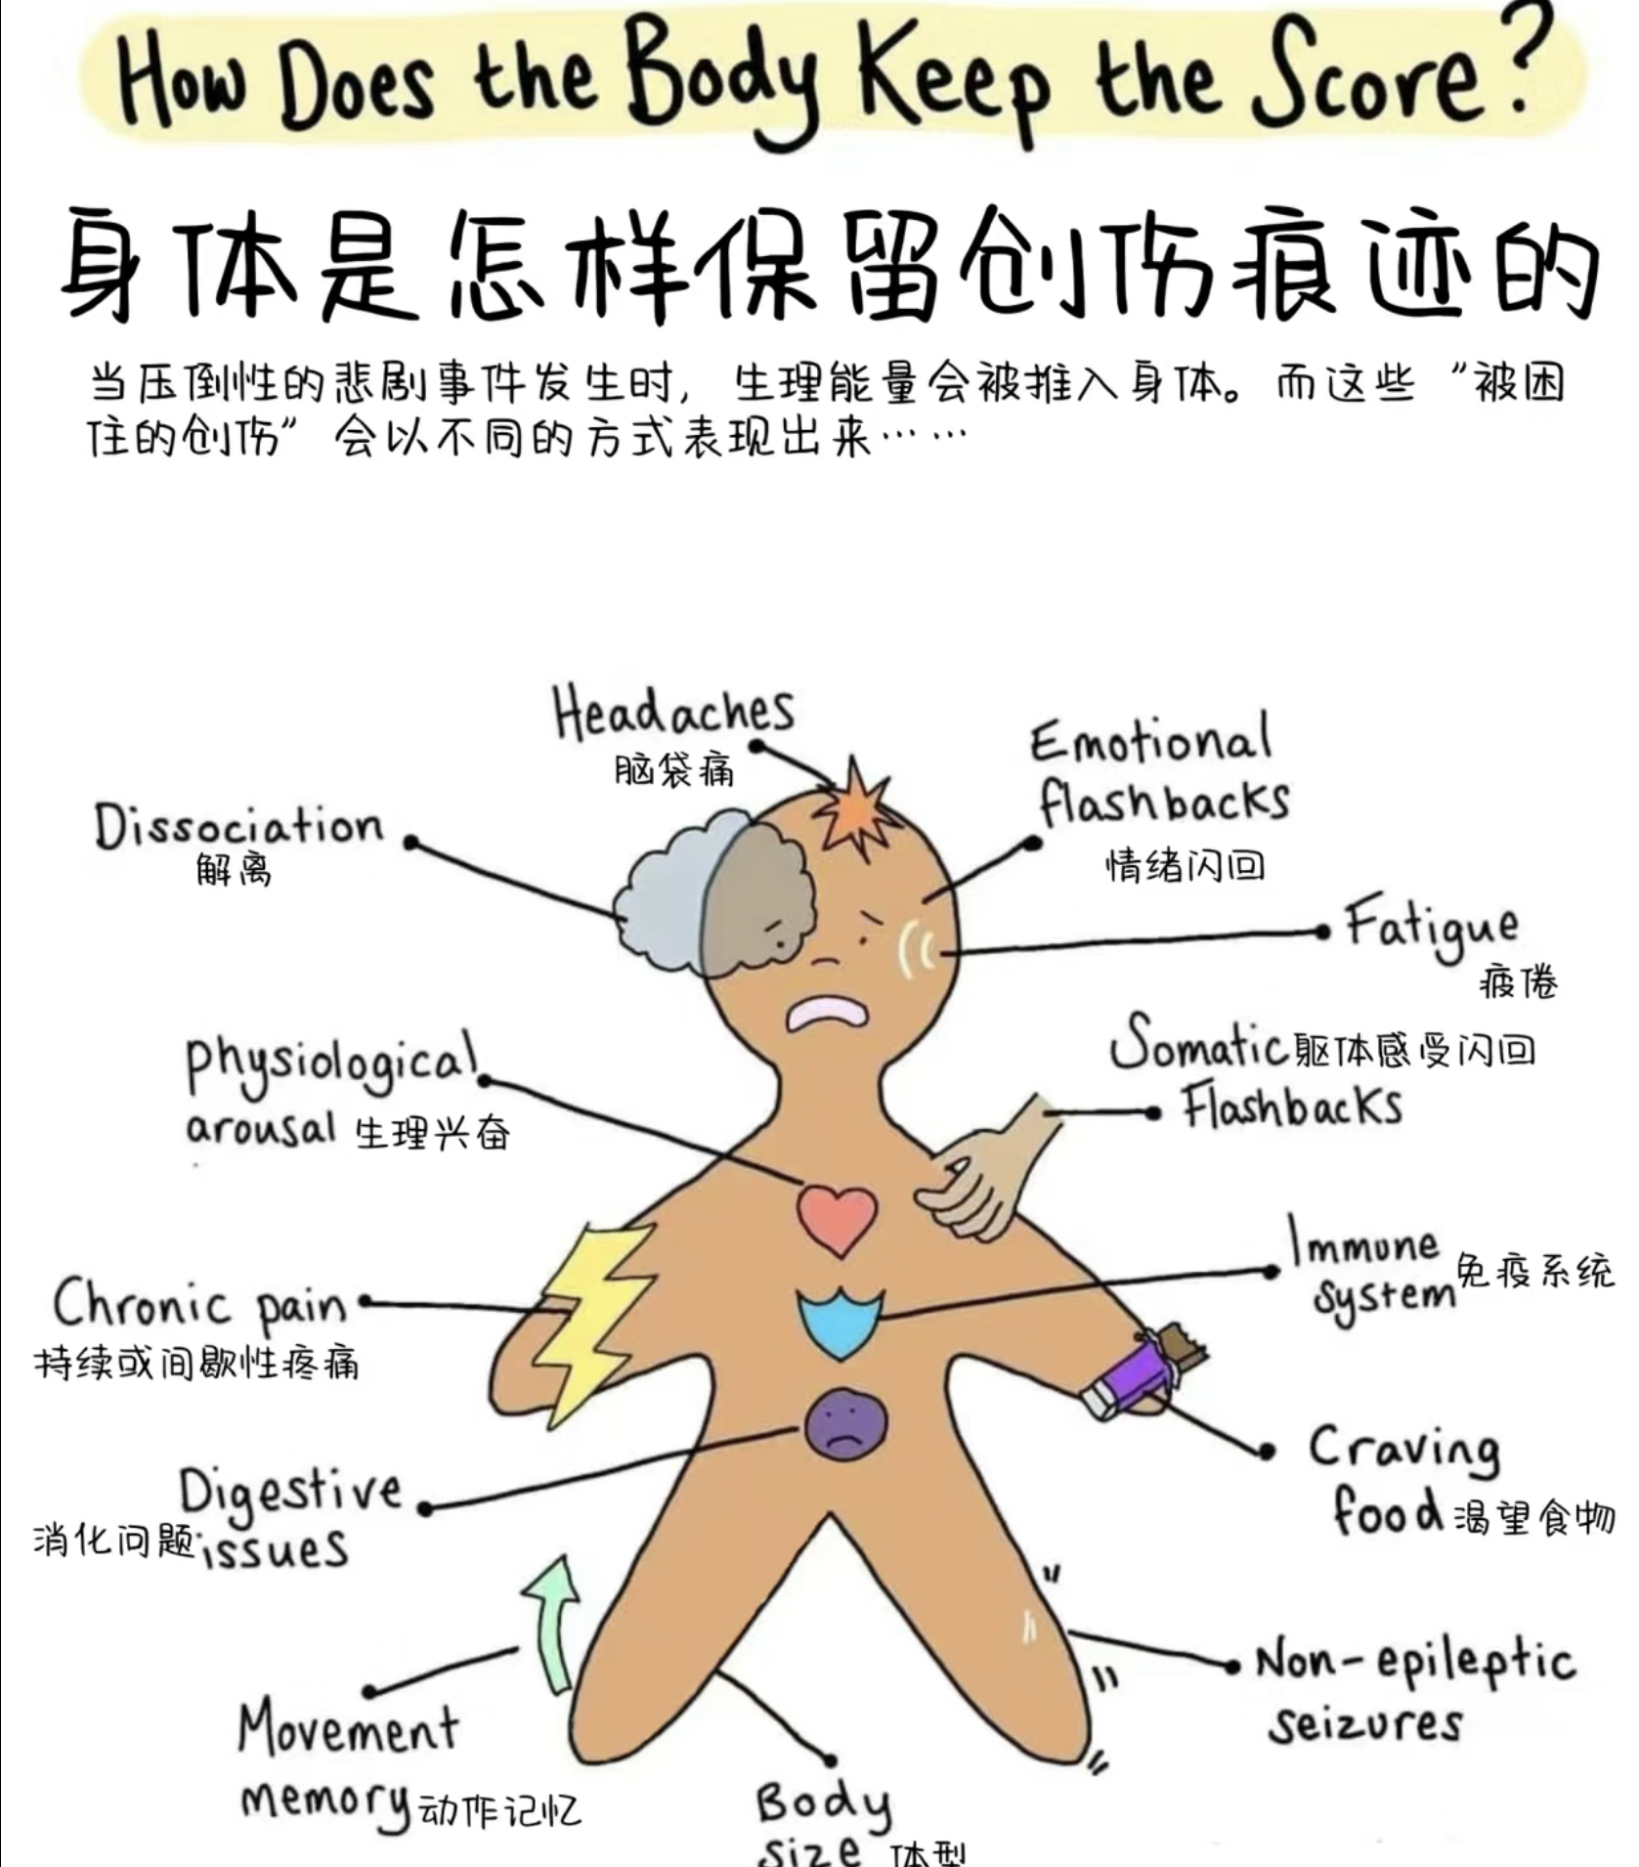
How does PTSD exist?
76 软软猴发布了一篇小红书笔记，快来看吧！ 😆 l2Vjl2ZT6OT3YfS 😆 http://xhslink.com/eJxDFA，复制本条信息，打开【小红书】App查看精彩内容！⬅️ A video about PTSD. Help you to understand.
Insecure, nervous and anxious, feeling that nothing is safe.
Seldom have any unplanned spontaneous will.
Disliking oneself, having an extremely negative self-image deep down.

Slide 5
How does PTSD been found ?
The concept and diagnostic criteria for PTSD were first established in the Diagnostic and Statistical Manual of Mental Disorders (DSM) (DSM-III) developed by the American Psychiatric Association, 3rd edition, which was subsequently adopted by the International Classification of Diseases (ICD). As the understanding of PTSD deepened, subsequent editions of the DSM and ICD have continuously revised and improved its content.
The earliest descriptions appeared during World War I, when the literature referred to war-induced "soldier irritability," "war neurosis," and "shell shock," and these early terms embodied the basic characteristics of PTSD.
E.g Soldiers in the Second World War suffered from a condition known as “shell-shock”, which we now know as PTSD.

Slide 6

Some ways for getting better
Deep breathing (mindfulness) meditation Pilates Yoga
⬆️These exercises involve breathing that mobilize the parasympathetic nerves, reduce brain alertness, restore relaxation and reduce stress.
Participate in social activities: square dancing, etc.
If you go to jump, don't shake your head, nod your head (shaking your head will make your mood more irritable) Do things with the same rhythm with a group of people, and you will have a connection with the world to ease your mood.

Slide 7

Thank you for listening!
Go to a professional doctor if you need!!!

