Slide 1
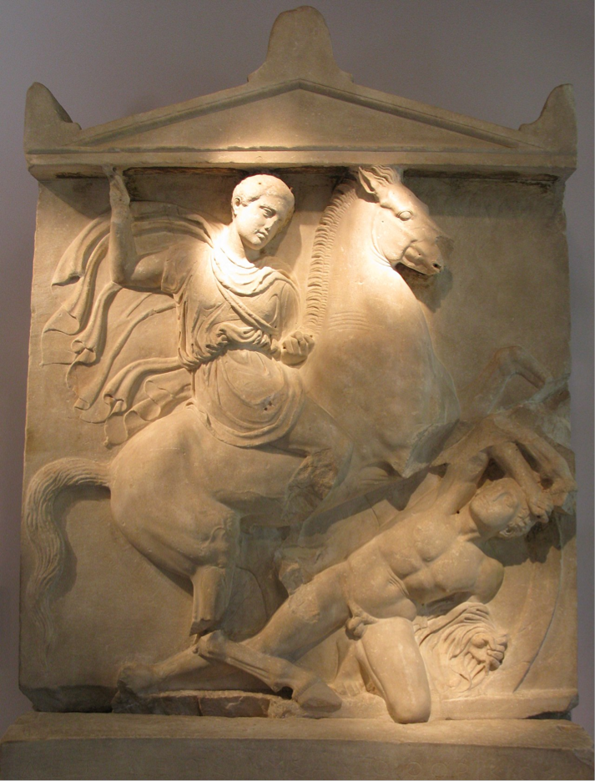
Ancient Greek Sculpture
Yara

Slide 2
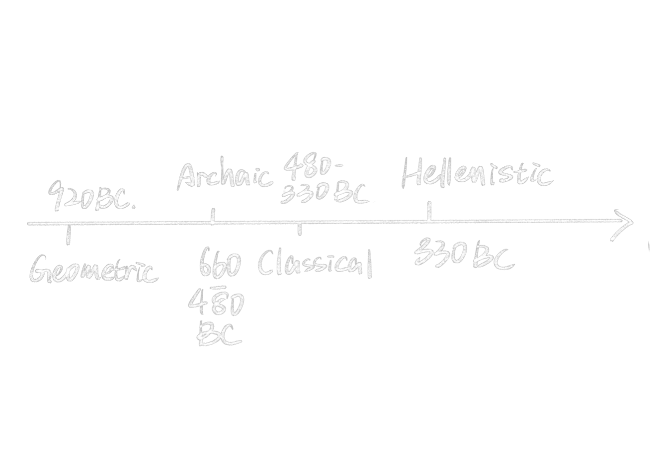


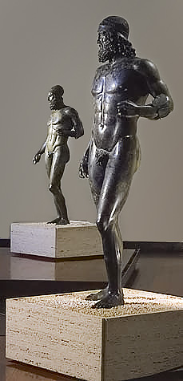
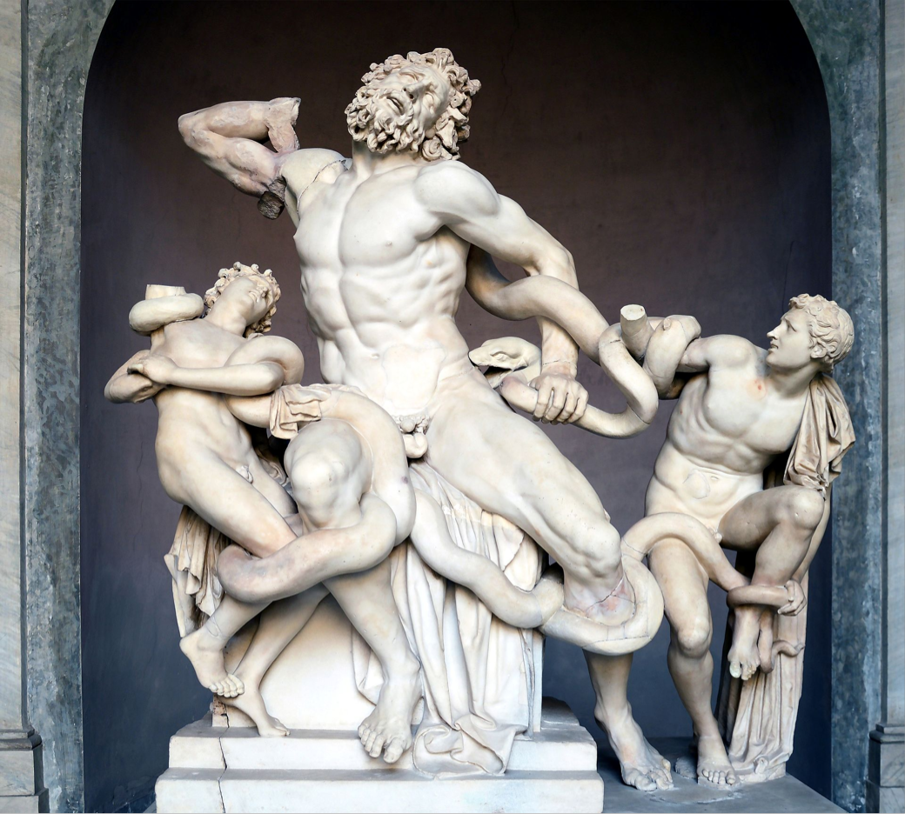
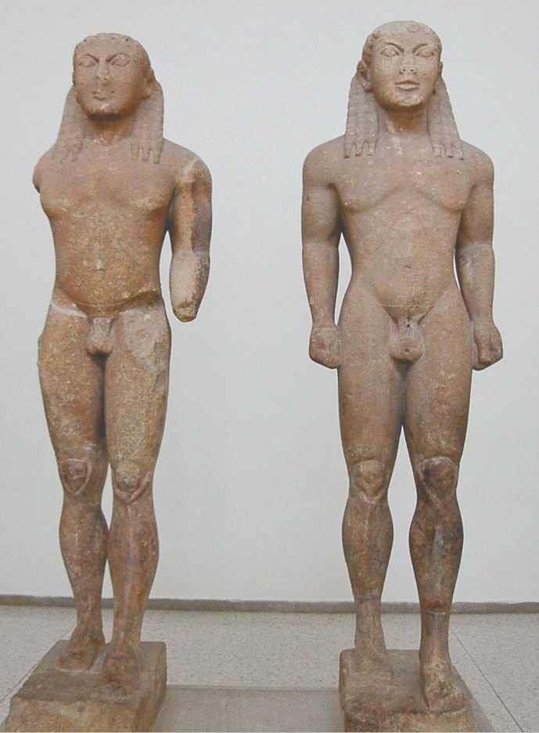

Slide 3
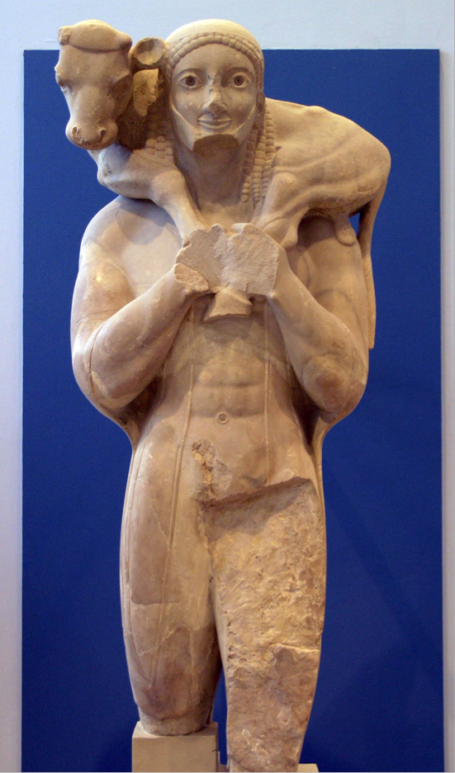
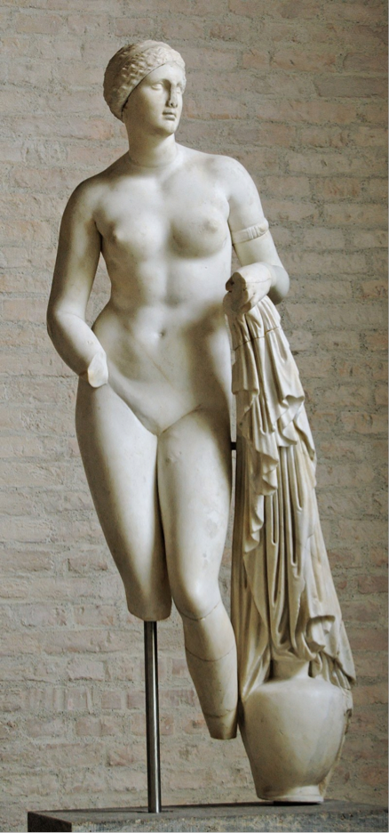
Archaic and Classical
ARCHAIC: Inspired by the monumental stone sculpture of ancient Egypt and Mesopotamia, the Greeks began again to carve in stone. Free-standing figures share the solidity and frontal stance characteristic of Eastern models, but their forms are more dynamic than those of Egyptian sculpture.
CLASSICAL:The Classical period saw a revolution of Greek sculpture, sometimes associated by historians with the popular culture surrounding the introduction of democracy and the end of the aristocratic culture associated with the kouroi. The Classical period saw changes in the style and function of sculpture, along with a dramatic increase in the technical skill of Greek sculptors in depicting realistic human forms. Poses also became more naturalistic, notably during the beginning of the period

Slide 4
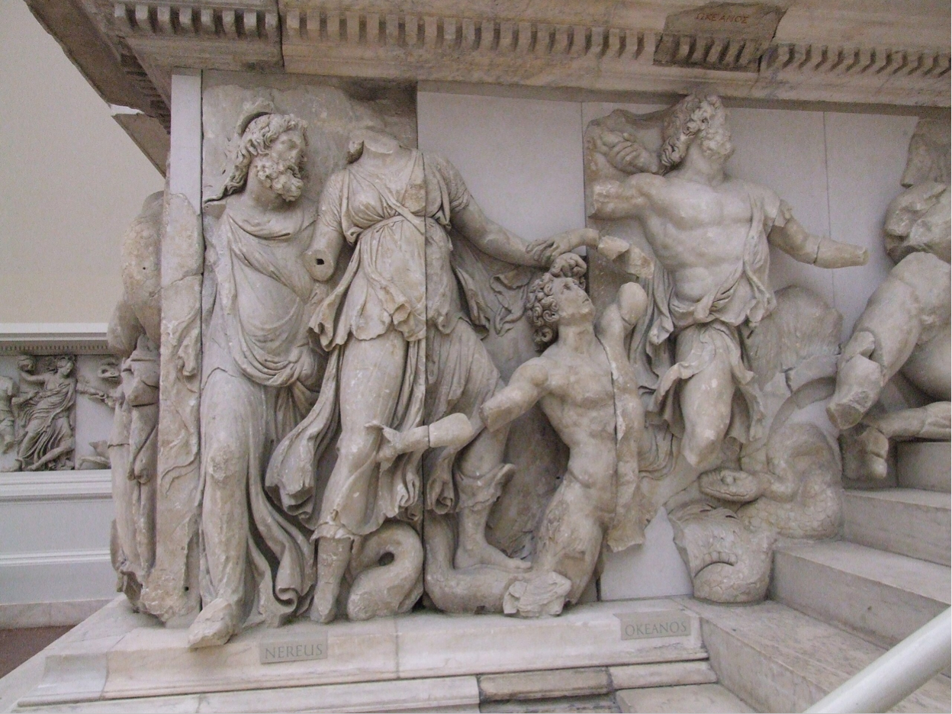
Hellenistic
HELLENISTIC:During this period, sculpture again experienced a shift towards increasing naturalism. Common people, women, children, animals, and domestic scenes became acceptable subjects for sculpture, which was commissioned by wealthy families for the adornment of their homes and gardens. Realistic figures of men and women of all ages were produced, and sculptors no longer felt obliged to depict people as ideals of beauty or physical perfection.

Slide 5
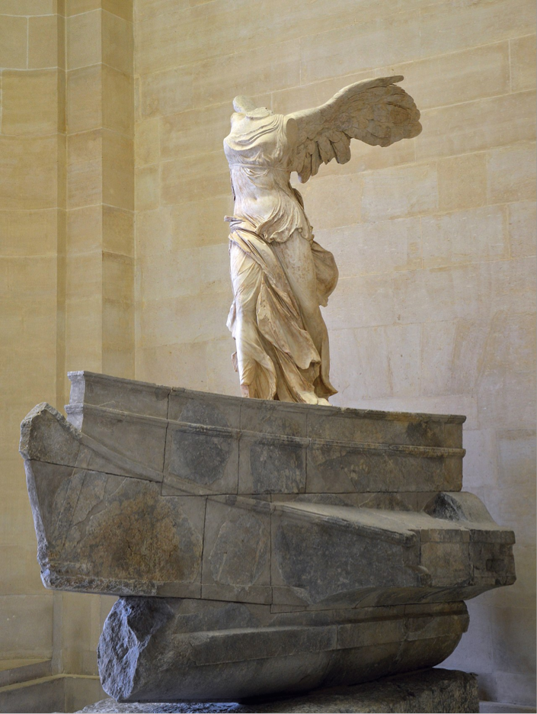
Hellenistic
The Winged Victory of Samothrace, or the Nike of Samothrace, is a votive monument originally found on the island of Samothrace, north of the Aegean Sea. It is a masterpiece of Greek sculpture from the Hellenistic era, dating from the beginning of the 2nd century BC . It is composed of a statue representing the goddess Niké, whose head and arms are missing and its base is in the shape of a ship's bow.
-The total height - 5.57 meters
-alone measures 2.75 meters.
-The sculpture is one of a small number of major Hellenistic statues surviving in the original
-has been exhibited at the Louvre Museum in Paris, at the top of the main staircase, since 1884.
Winged Victory of Samothrace

Slide 6
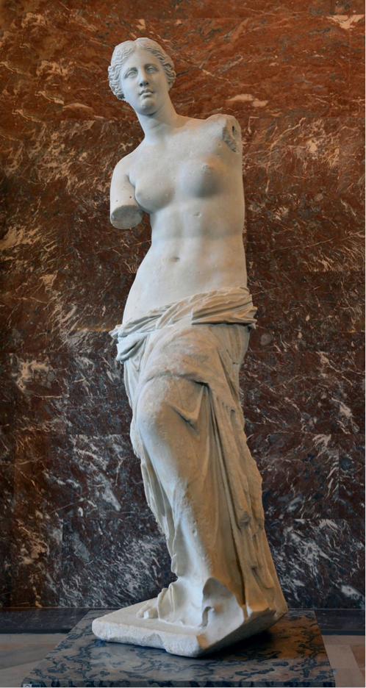
Hellenistic
The Venus de Milo or Aphrodite of Melos is an ancient Greek marble sculpture that was created during the Hellenistic period. It was rediscovered in 1820 on the island of Milos, Greece, and has been displayed at the Louvre Museum since 1821. Since the statue's discovery, it had become one of the most famous works of ancient Greek sculpture in the world.
The Venus de Milo is believed to depict Aphrodite, the Greek goddess of love, whose Roman counterpart was Venus. Made of Parian marble, the statue is larger than life size, standing over 2 metres high. The statue is missing both arms. On the basis of a now-lost inscription found near the sculpture, it has been attributed to Alexandros from Antioch on the Maeander, though the name on the inscription is uncertain and its connection to the Venus is disputed.
The Venus de Milo

Slide 7
Thank you!

