Slide 1




ALEXANDER FLEMING
DISCOUVERED PENICILLIN
Alexander Fleming
Penicillin
Trista

Slide 2

CONTENTS
01.
02.
03.
Alexander Fleming
Penicillin
Timeline
Personal Introduction
Definition,
Types...
Before &
Nowadays

Slide 3
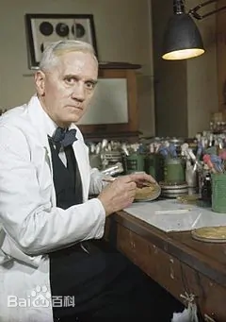


Alexander Fleming
  Scottish Bacteriologist
  World War I: the few doctors who mastered the advanced technique of intravenous injection
  World War II: the anticoagulant effect of sodium citrate and the clotting effect of calcium were used as blood transfusions for the wounded
  Discovered lysozyme in 1923, discovered penicillin in 1928
输入正文
  Accident

Slide 4
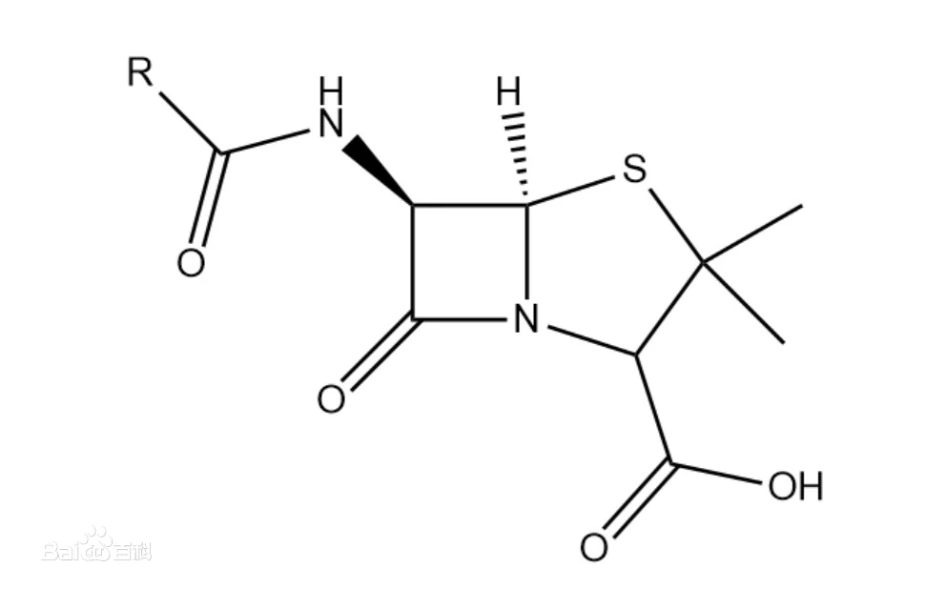


Penicillin
  A kind of antibiotic, refers to the molecule contains penicillane, can destroy the cell wall of bacteria and play a bactericidal role in the reproductive period of bacterial cells
Definition
  Acid-resistant penicillin
  Enzyme resistant penicillin
  Natural penicillin
Types
  Fight with bacterial infection
  Prevent inflammation during surgery
Application

Slide 5
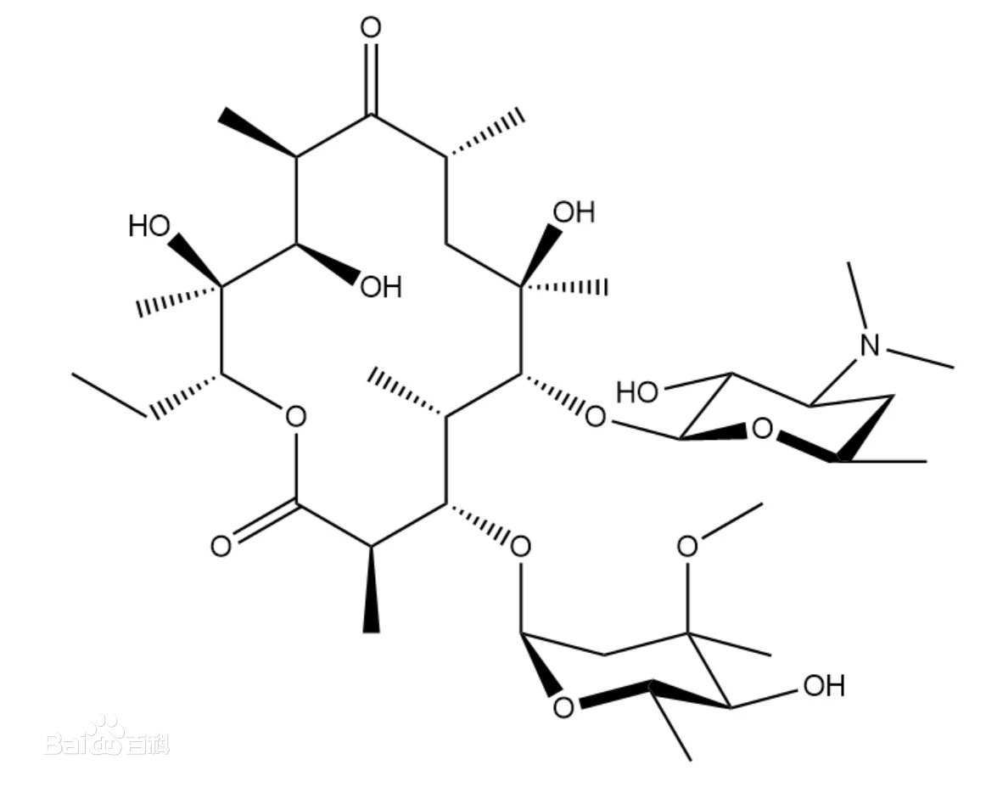
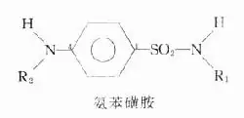

Timeline
Before Alexander Fleming Discovered Penicillin
Erythrocin
Discovered in 1952
Mainly used for respiratory infections
Sulfonamides
Invented in 1930
Used to treat inflammation
Susceptibility to drug resistance
Cause renal toxicity
Widow's head ash
Invented in B.C.470
In the dark environment, the mold ash grows rapidly, and the penicillin in the mold ash contains penicillium plays a good inhibitory effect on bacteria, killing bacteria and eliminating inflammation

Slide 6


Timeline
Effect
Results
Avoid death from injury and infection
The average human lifespan has been extended
It saved 12 to 15 percent of the soldiers' lives
After the war, penicillin was made available for civilian use.
When penicillin was just discovered

Slide 7

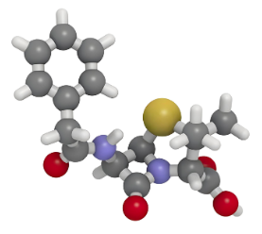

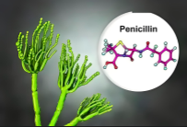




Timeline
Nowadays
Why?
How?
Kill microorganisms that cause a variety of diseases, including acute infections caused by sensitive bacteria.
Intramuscular injection or intravenous drip
Mix in tablets
Reflection
Side effect
The invention of drugs is an advance, but the risk of overusing antibiotics makes us realize that we must be cautious enough about technological progress.
Anaphylaxis
Herr's reaction
Penicillin encephalopathy

Slide 8
ALEXANDER FLEMING
DISCOUVERED PENICILLIN
Thanks!
Trista

