Slide 1
The Beatles
their wondrful life
1960
Presented by: Amily ｜ Class: 912 ｜ Date: 2024/01/17

Slide 2
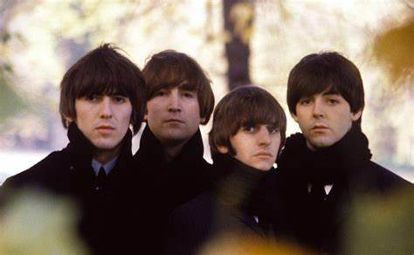
CONTENTS
01
Who are they
02
Their own lives
03
Being a band
04
Breaking up

Slide 3
RART 01
Who Are They?

Slide 4

A BAND!!!
Name : The Beatles
Country : Liverpool, England
Style : Rock band
Time : 1960
Members : John Winston Lennom, Sir Ringo Starr, Paul McCartney, George Harrison
A
Super
Simple
Introduction

Slide 5
RART 02
Their Own Lives

Slide 6
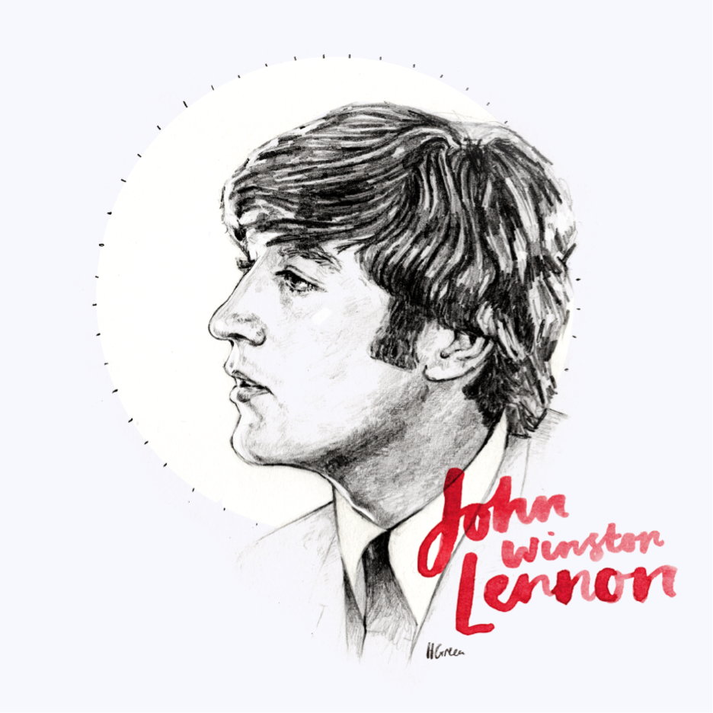



John Winston Lennon
He was born into a working-class family in Liverpool, England, and lives with his aunt Mimi and uncle George. Perhaps due to the loss of his father, he has always been a very disobedient and rebellious child, often skipping school and not doing homework well. Instead, he writes and scribbles in his homework notebook.
1955
1956
1960
He organized a rock band called "The Quarrymen" at Quarry Bank, singing all the parade songs, which was the predecessor of The Beatles. He has always served as the main singer and lyricist of the band.
The principal of Lennon's high school, who is 16 years old, wrote a letter of recommendation for him to study at an art school in Liverpool..
Lennon formed his "Beatles" and began performing in clubs around the world. The first single "Please Please Me" was born.

Slide 7

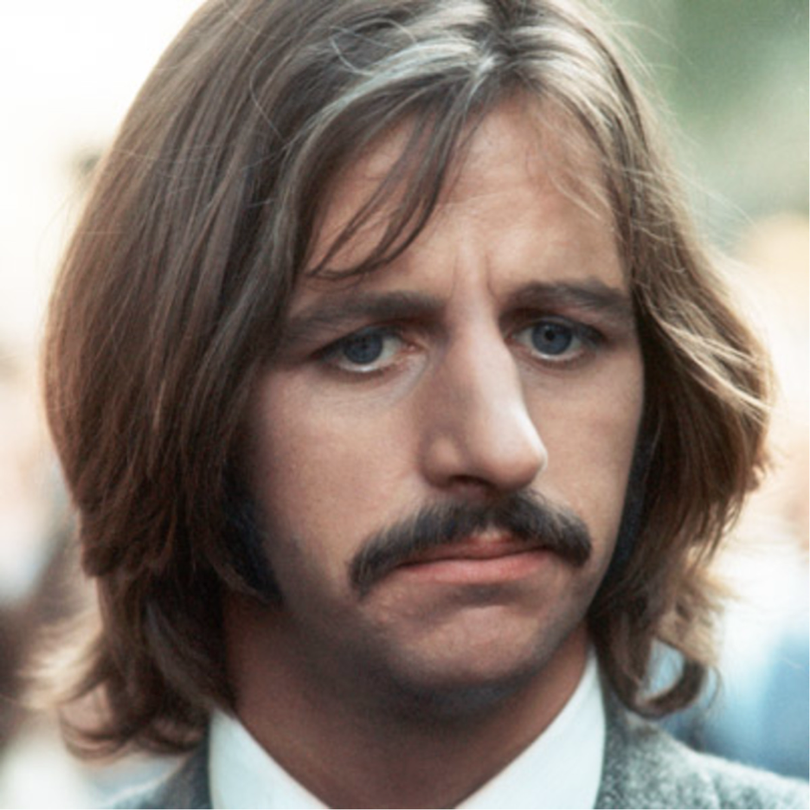
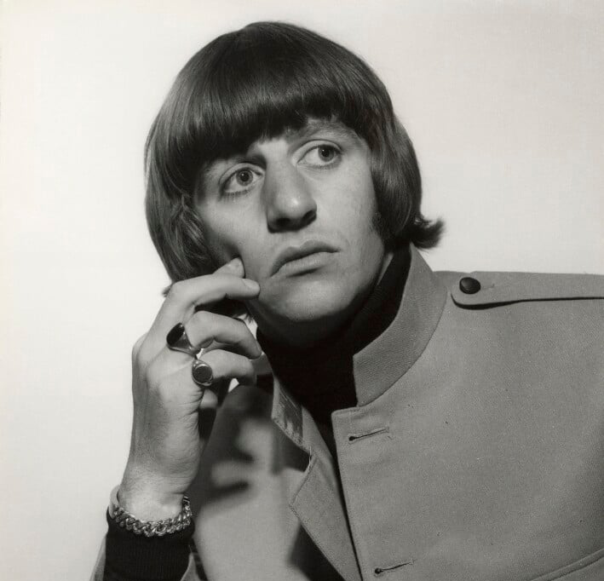
Sir Ringo Starr （the drummer）
He was born in England, and his father is a cake maker. Lingo's parents separated when he was three years old, and eight years later his mother married Harry Graves, which sparked Lingo's interest in music. In his childhood, he went to the Evangelical Anglican Church for worship and was plagued by illness. He attended the Saint Seras School near his home, and then went to Dingle Vale High School, where he demonstrated his talent in music and drama. The reason why he is prone to illness is that he will also have many troubles when he is in the band.

Slide 8
RART 03
Being A Band

Slide 9



单击添加副标题
There are many variations of passages of Lorem
Tour to Hamburg, Germany
1960
Experience in the United States
1964
Signed with a record company
1962

Slide 10

单击添加副标题
There are many variations of passages of Lorem
25
200
14
10

Slide 11

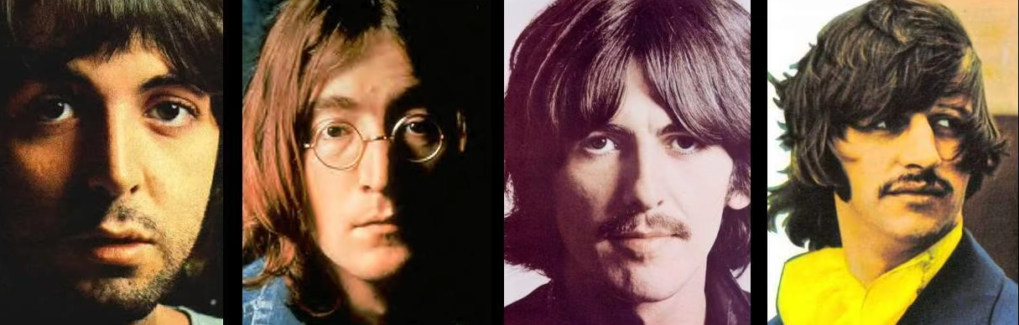

Art
True Rock
Culture

Slide 12
【The Beatles - Hey Jude 【4K修复】-哔哩哔哩】 https://b23.tv/owHYfrf

Slide 13
RART 04
Breaking Up

Slide 14
Thanks
2024
Presented by: Amily ｜ Class: 912 ｜ Date: 2024/01/17

